Slide 1

Kendo UI widgets Intro
Widgets
Initialization add few words explaining what is that
Imperative and declarative initialization;
Configuration;
Structure;
Using widgets;
Widgets life;
Widgets globalization;
Widgets localization;
Notes:
Every Kendo UI widget is actually an JavaScript object that has element and wrapper. During initialization Kendo may add other elements as well.

Slide 2
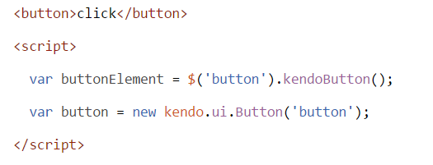
Initialization
Kendo UI widgets are initialized as jQuery plugin (returns selected DOM element)
[element].kendo[WidgetName]();
new kendo.ui.[WidgetName]([element],{configuration});
[WidgetName] - kendo UI widgets (Button, AutoComplete, Grid, etc.)
[element] – any valid jQuery selection;
{configuration} - JavaScript object for some widgets optional, for other compulsary;
http://dojo.telerik.com/AXIzO

Slide 3

Configuration
With configuration object during initialization
Configuration object is JavaScript object with one or more key: value pairs
key is the setting name,
value is property, method or event handler
http://dojo.telerik.com/ojeFA

Slide 4
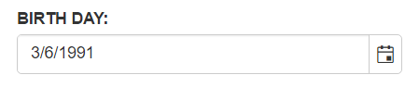
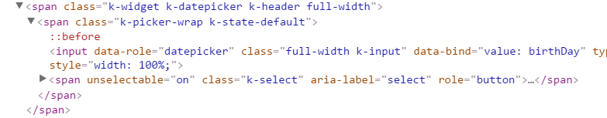
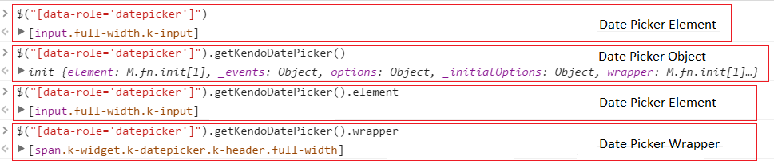
Structure
elements structure.
Element
Wrapper
Helping Elements
http://dojo.telerik.com/APUdi

Slide 5
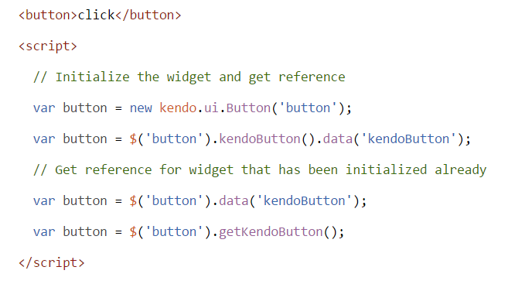
Using Widgets
Getting widgets reference.

Slide 6
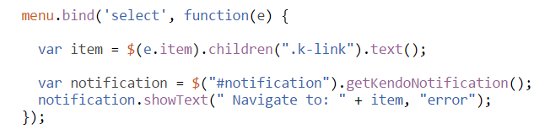
Using Widgets
Calling Widgets methods and subscribing to events.
http://dojo.telerik.com/ukEjU

Slide 7

Widgets Life
Widgets initialization;
Initialized on demand
Widgets removal;
Removed when page is unloaded;
http://dojo.telerik.com/UsONu

Slide 8
Forms Validation
Kendo Validator
Properties;
rules - Set of custom validation rules. Those rules will extend the built-in ones.
messages - Set of messages (either strings or functions) which will be shown when given validation rule fails. By setting already existing key the appropriate built-in message will be overridden.
Methods;
validate - Validates the input element(s) against the declared validation rules.
errors - Get the error messages if any.
Events;
validate - Fired when the validation of the form completes.
http://dojo.telerik.com/iLIlo

Slide 9
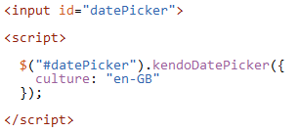

Widgets globalization
Setting Culture.
Formatting and parsing Dates.
Formatting and parsing Numbers.
http://dojo.telerik.com/UJEMoY
http://docs.telerik.com/kendo-ui/framework/globalization/overview

Slide 10
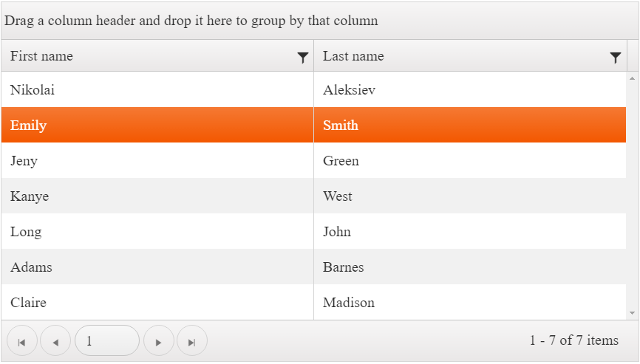
Configuring Kendo UI Grid
http://dojo.telerik.com/uroFe
http://docs.telerik.com/kendo-ui/api/javascript/ui/grid

Slide 11
Common settings
enable – most interactable widgets
value – initial value for widgets like Slider, Radial Gauge, ProgressBar
culture – specific cluture for the widget (“en-US”, “en-GB”, etc)
dataSource – used by most widgets that retrieve or manipulate data from remote source
height, width – define widget size in pixels
editable – grid, editor and other input widgets
messages – allows localization of the strings used in the widget

Slide 12
Common methods
enable() – enables or disables input type widets
bind() – part of jQuery, allows you to bind to events
value() – gets or sets widget value for input type widgets
select() – selects one or more data elements in container widgets
setOptions() – set widget settings after initialization
setDataSource() – set widget dataSource after initialization
max(), min() – get maximum/minimum value for input type widgets
dataItem() – gets the data item for container widgets
refresh() – redraws the widget
destroy() – destoys widget by releasing memory

Slide 13
Q & A

